Slide 1
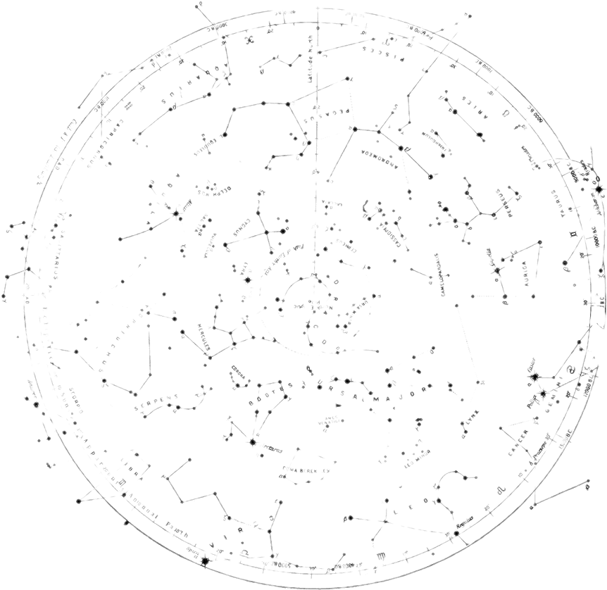

Board Design In Autodesk Eagle
THE SESSION WILL BEGIN SHORTLY
Presented by:
Jacob Lawson

